Slide 1

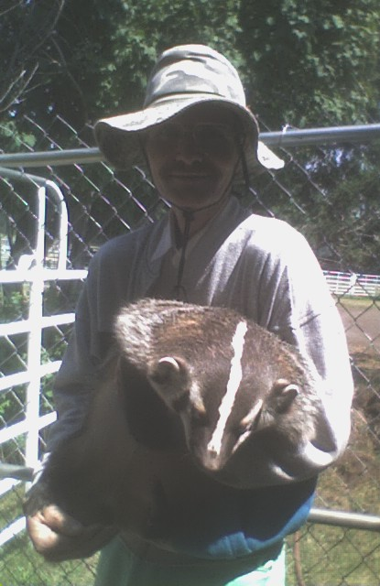
Me, with my niece’s pet badger

Slide 2
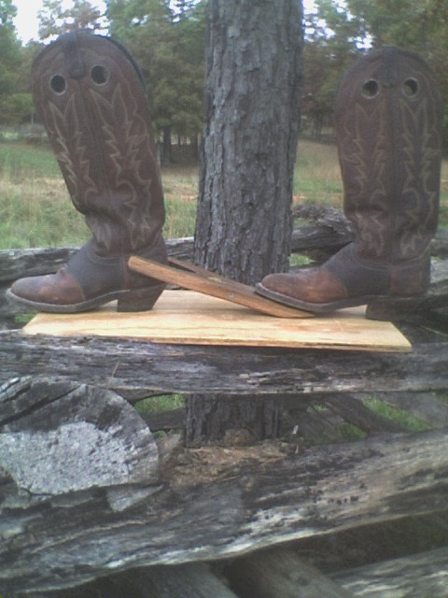
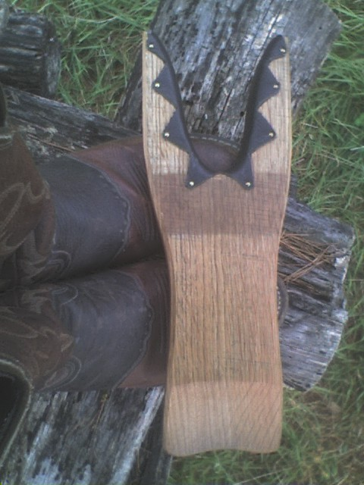
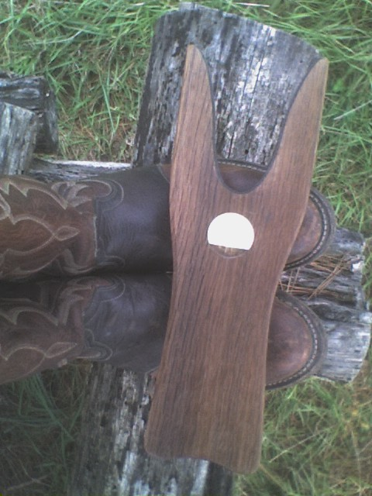
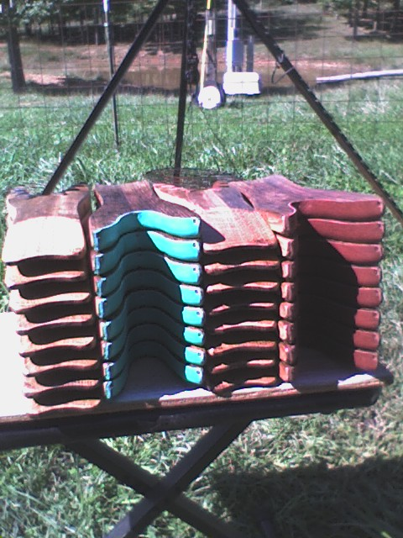
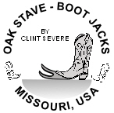
I make Bootjacks on the side
Side view
Bottom
Top view
Leather lined jaws
Made from White Oak Barrel Staves, custom trademarks and leather colors
← Click to print order form

Slide 3
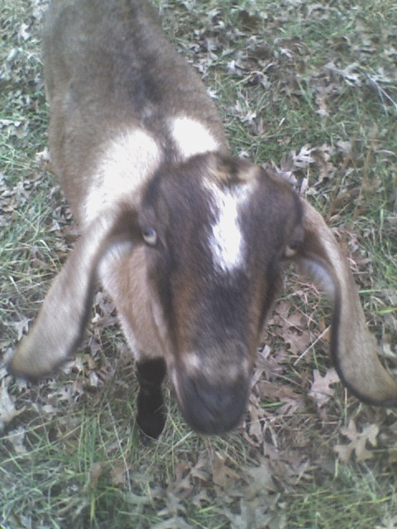
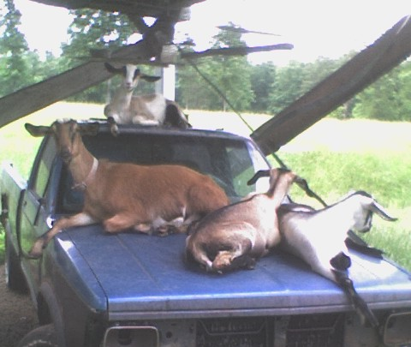
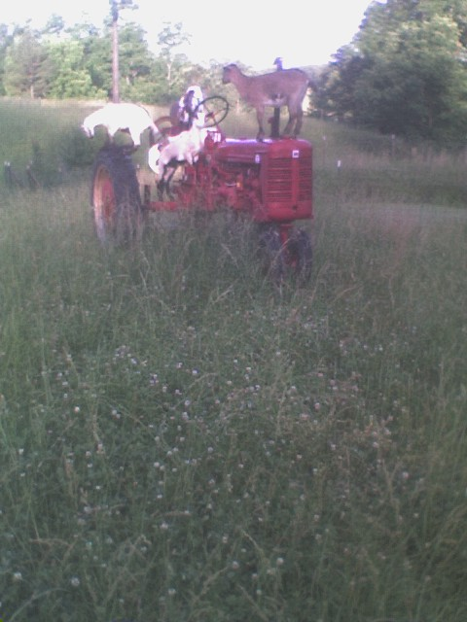
I like raising goats for milk and meat
This year’s pickup goats
They like the tractor too
This is “Little Missy”
I try to keep two adult doe’s and sell the kids at market each year to manage the grass. I have eight acres, about half of it is grass

Slide 4
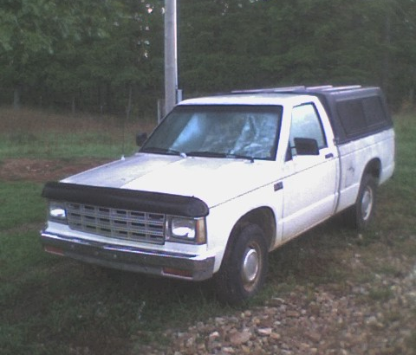
I like to work on my own vehicles
This is my 1990 GMC S-15 Pickup. I don’t let the goats get on it, only the blue 4x4

Slide 5
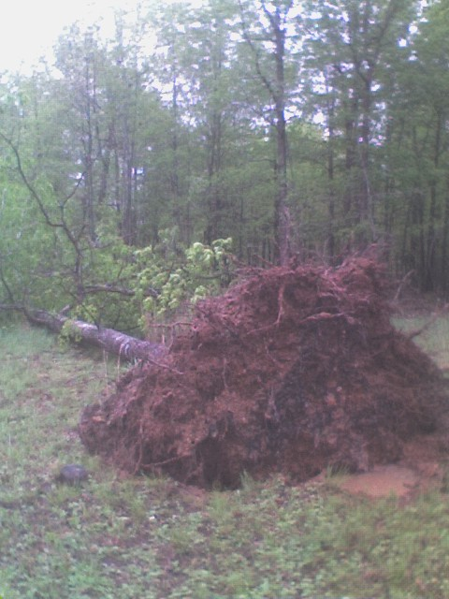
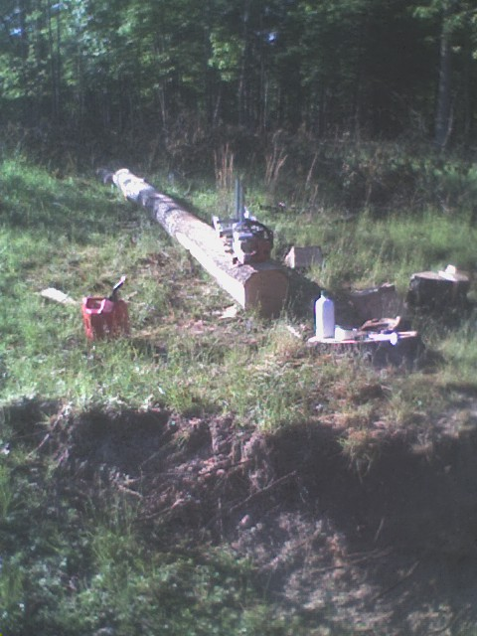
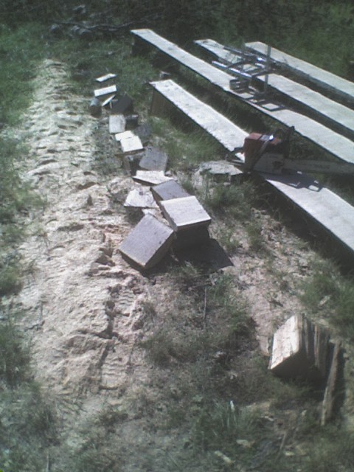
I occasionally mill some lumber
This is the same red oak tree in each picture, it blew over last year (2009). I used my portable hand held Alaskan chainsaw mill to make some lumber with. You can see how the stump tipped back into place

Slide 6
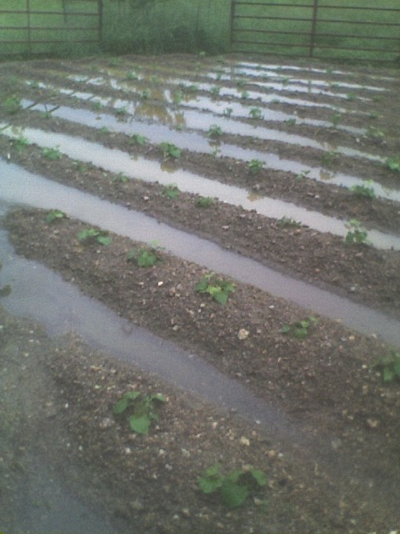
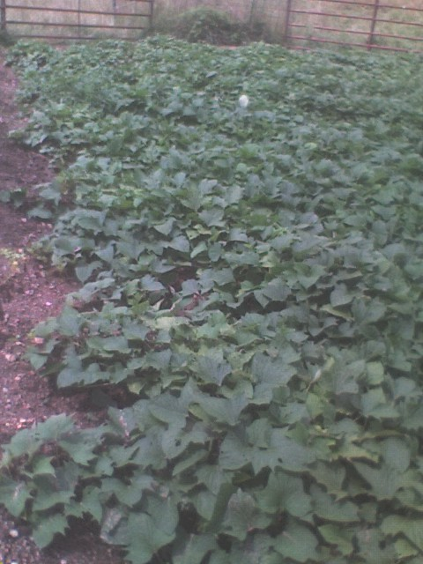
I like to garden
These are last years sweet potatoes after a storm, and later that year

Slide 7
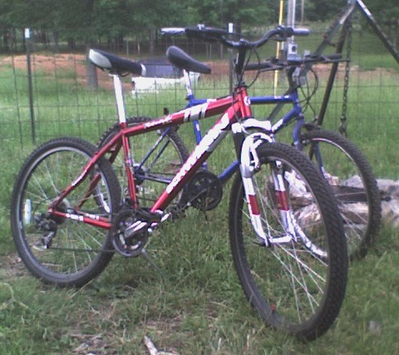
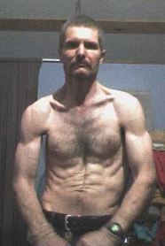
I like to cycle and exercise
These are my two mountain bikes, I get plenty of exercise from them. I rebuilt my left shoulder after an injury from a fall from a tree

Slide 8
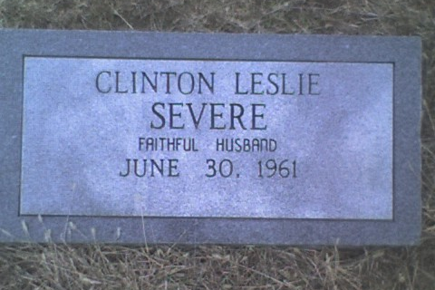
I have my grave all ready
Part of me is in the grave already (two organs and some teeth) so I thought I’d better make a place for myself. I’m still living up to my epitaph. This headstone is unfinished until they plant me, it’s in the McMaham cemetery

Slide 9
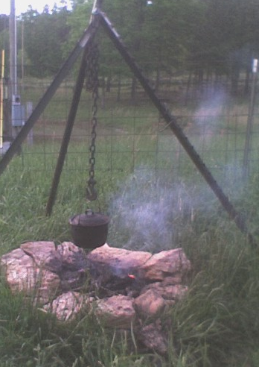
I like to cook on my out door fireplace
Three steel fence posts in a tripod suspends a pot of beans over the fire. I welded a chain to the intersection, and made an adjusting hook to adjust the chain height with

Slide 10
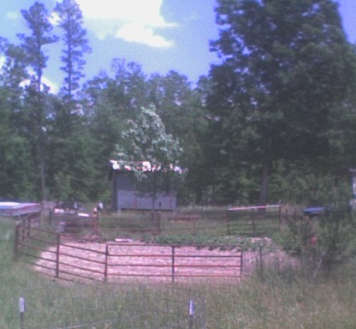
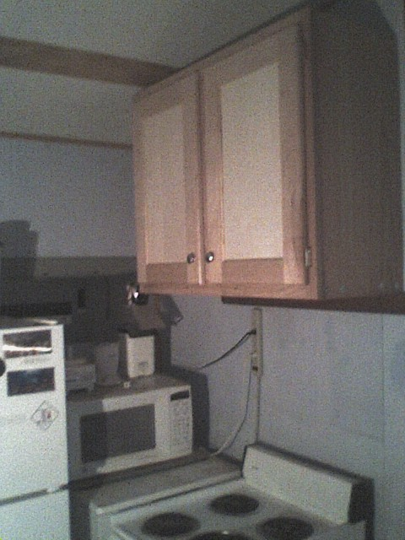
My little house on the prairie
I built my own (12’x 20’ inside) studio house in 1998, the cabinets were made at Shriver’s where I was a cabinet door maker for several months. I made these doors out of 3” Maple rails and styles

Slide 11
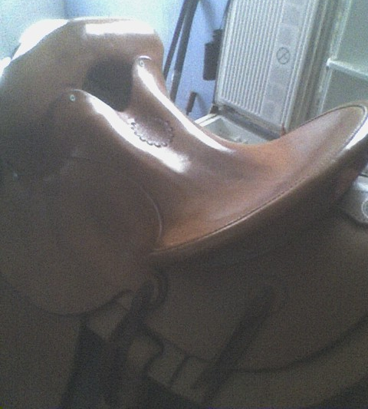
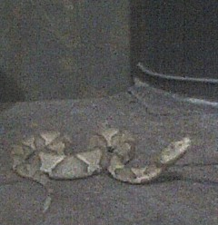
Some custom saddle work and stuff
A mug shot of a copperhead from the woods, on my stove
I came from a family that makes custom saddles, this is a saddle I customized by removing the ground seat. It gives it the feel of the old McClellan Army saddles. I had my brother cover it with bull hide after I re-shaped the old Hamley wooden tree, another brother finished it

Slide 12
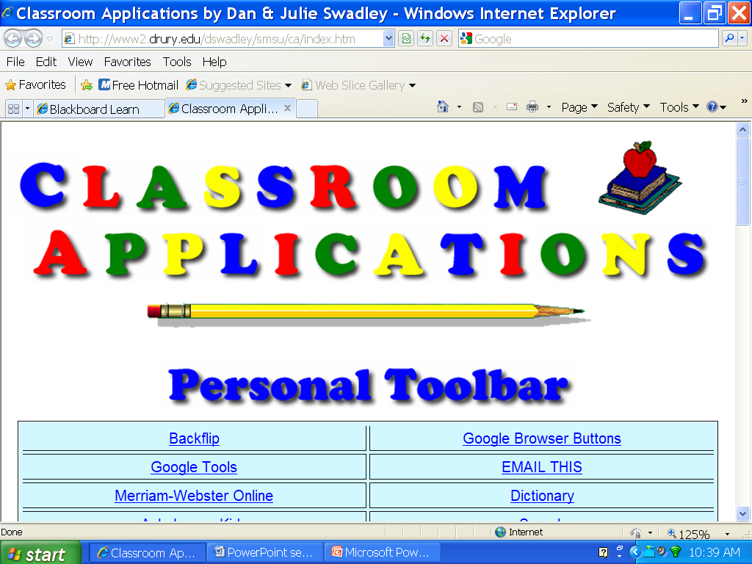
This is the last slide
← Link
Recently I’ve been studying at Drury University. This slide presentation is from an assignment in Desktop Applications.
Notes:
The ‘apple graphic’ is from this site http://www2.drury.edu/dswadley/smsu/ca/index.htm Click graphic to see Drury University

